Slide 1
Crawl, Walk, Talk WP8.1 App Lifecycle and Speech API
Danny Warren
@dannydwarren

Slide 2
About Danny & InterKnowlogy
InterKnowlogy (www.interknowlogy.com)
15 year old services firm – Custom Application Development
Focused on building NUI solution
Windows 7/8, Touch, WP8, Kinect, Azure, XAML
Web, Mobile, and Desktop
Formal R&D program: RECESS
Self guided learning
Danny Warren, Sr. Software Engineer
Graduate Neumont University 2009, B.S. C.S.
.NET 4.0 Microsoft Certified Professional Developer
Nokia Champion for Windows Phone
Avid Mt. Biker and aspiring Rock Climber

Slide 3


App Lifecycle
Invisible but EXTREMELY important!
Affects
UX
Data
Possible Facial Side Effects
GOOD
BAD

Slide 4
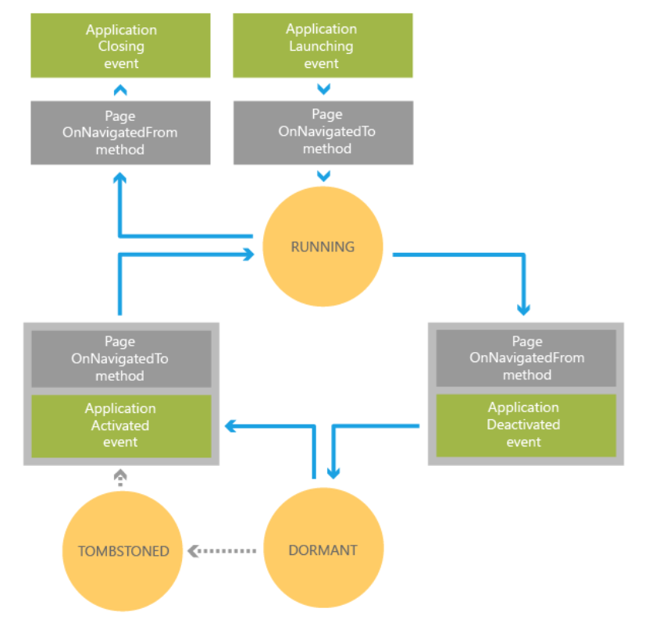

Slide 5
WP8 Speech API
Voice Commands
VCD.xml file
Used to Launch Apps
Speech Recognition
Grammars
Recognizers
Text-To-Speech (TTS)
Error Help Here

Slide 6
Voice Commands
Create VCD.xml File
Register VCD File
Update Phrase Lists
Declare Capabilities in WMAppManifext.xml
Microphone
Speech Recognition
Networking

Slide 7
Text-To-Speech (TTS)
Select a Voice
Default is en-US
Can be specified via SRGS file
Literally stick words in the phone’s mouth!

Slide 8
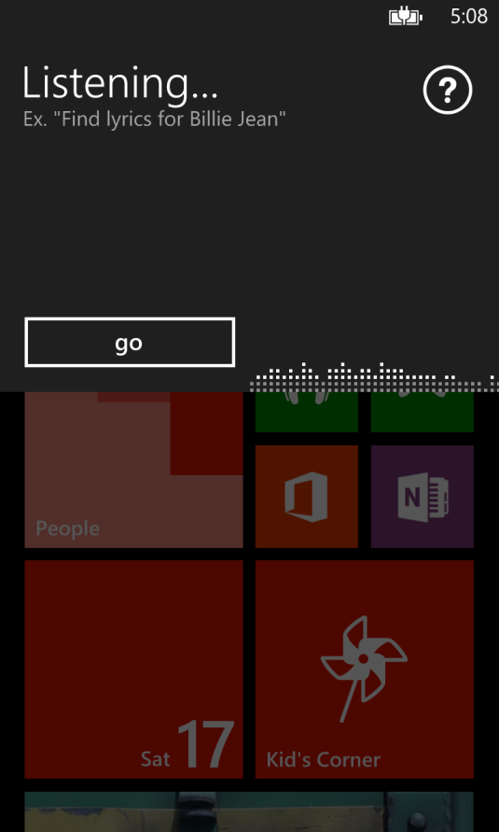
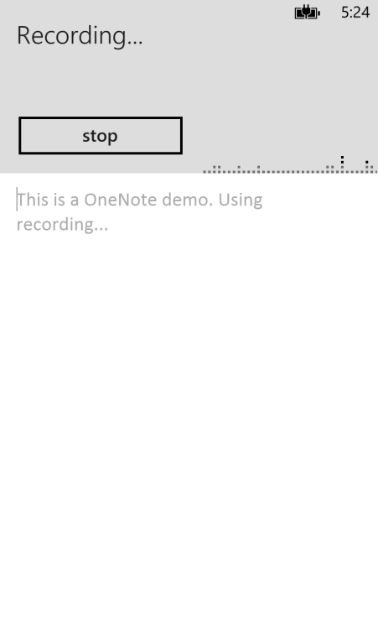
Speech Recognizers
SpeechRecognizerUI
SpeechRecognizer
Uses built in Speech UI
Good for basic uses
App must provide any desired UI for interaction
Good for custom uses

Slide 9
Choosing Between Grammars
Dictation and Web Search Grammar
This is the built in grammar
Must have network connectivity to use
Used by default when no other grammar specified
Programmatic List Grammar
Created in code from a list of strings
Extremely light weight, fast, and accurate
Speech Recognition Grammar Specification (SRGS File)
Extremely flexible
Fast and accurate

Slide 10

We Want YOU!
Contact Us
findyourcalling@interknowlogy.com mention devLink

Slide 11
Download Materials
http://blogs.interknowlogy.com/author/dannywarren/

